Slide 1
Visual Studio 2017 Launch Event
Gowtham K

Slide 2
Agenda
Improved Performance & Productivity
Live Code Analysis
Live Unit Testing
C# 7.0

Slide 3
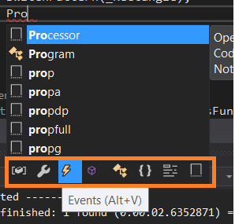
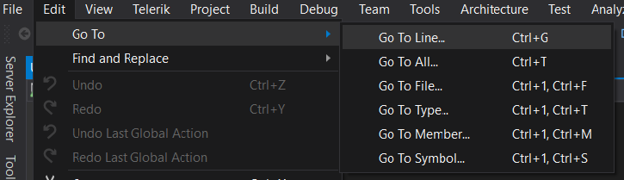
Performance & Productivity
Start & Shut Down Time – 4x time faster than VS 2015
Solution Build – 3x time faster than VS 2015
Shortcuts – New Goto in Edit
Filter in Intellisense

Slide 4
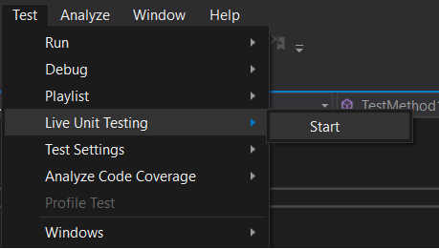
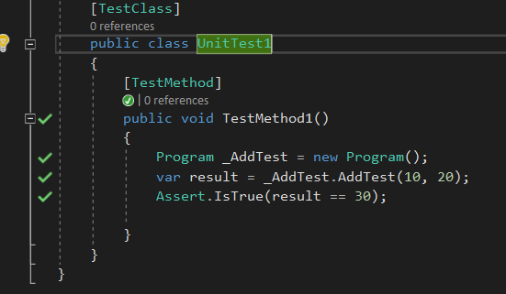
Live Unit Testing
Running the Unit test functions without running the Solution is possible in VS 2017
Available only in Enterprise Version

Slide 5
C# 7.0
Binary Literals
Local Function
Pattern Matching
Tuples

Slide 6
Binary Literals
C# 7 supports binary literals along with decimal and hexadecimal literals
We can use 0b or 0B for binary literals

Slide 7
Local Function
Nesting the function inside the function is called Local function
Scope will be within the function where it is defined

Slide 8
Pattern Matching
Pattern matching is new kind of language element in C#, Used to test the values in various place
We can perform pattern matching with any datatype
It can extract the values from the expression
C# 7.0 Support pattern matching with “is” expression and the Switch Statement

Slide 9
Tuples
It is value type used to return more than one value from the function

Slide 10
Reference Link
https://docs.microsoft.com/en-us/dotnet/articles/csharp/csharp-7
https://docs.microsoft.com/en-us/visualstudio/ide/whats-new-in-visual-studio
https://www.visualstudio.com/en-us/news/releasenotes/vs2017-relnotes

